Slide 1

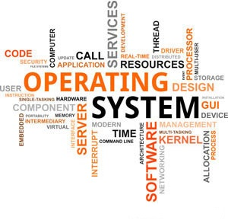

3140702
Operating System
Unit - 1
Introduction
Prof. Firoz A. Sherasiya
9879879861
firoz.sherasiya@darshan.ac.in

Slide 2
Topics to be covered
Computer system overview
Computer system architecture
Definition of Operating System (OS)
Objectives / Goals of Operating System (OS)
Generations of Operating Systems (OS)
Operating Systems (OS) services
Types of Operating Systems (OS)
System calls
Operating Systems (OS) structure
Multiprogramming v/s Multiprocessing v/s Multitasking
Time Sharing Operating System
Parallel Processing Operating System
Distributed Operating System

Slide 3
Basic elements of computer
Processor
I/O Modules
System Bus
Main Memory

Slide 4
Processor
Referred to as the Central Processing Unit (CPU)
Arithmetic & Logic Unit
Control Unit
Performs the data processing functions
Controls the operation of the computer

Slide 5
Main memory
Volatile
Contents of the memory is lost when the computer is shut down
Referred to as primary memory or RAM.

Slide 6
I/O modules
Input/output module is a device that acts as the connective bridge between a computer system at one end and an I/O or peripheral device at the other, such as a printer, webcam or scanner.
Moves data between the computer and external environments such as:
storage (e.g. hard drive)
communications equipment
terminals

Slide 7
System bus
Provides communication among
processors, main memory,
and I/O modules.

Slide 8
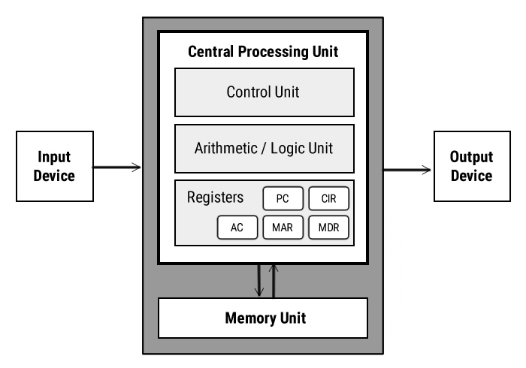
Computer system architecture

Slide 9
Input unit
It provides data and instructions to the computer system.
Commonly used input devices are keyboard, mouse, magnetic tape etc.
Input unit performs following tasks:
Accept the data and instructions from the outside environment.
Convert it into machine language.
Supply the converted data to computer system.

Slide 10
Output unit
It connects the internal system of a computer to the external environment.
It provides the results of any computation, or instructions to the outside world.
Some output devices are printers, monitor etc.

Slide 11
Storage unit (Memory unit)
This unit holds the data and instructions.
It also stores the intermediate results before these are sent to the output devices.
It also stores the data for later use.
The storage unit of a computer system can be divided into two categories:
Primary Storage
Secondary Storage

Slide 12
Primary Storage
This memory is used to store the data which is being currently executed.
It is used for temporary storage of data.
The data is lost, when the computer is switched off.
RAM is used as primary storage memory.

Slide 13
Secondary Storage
The secondary memory is slower and cheaper than primary memory.
It is used for permanent storage of data.
Commonly used secondary memory devices are hard disk, CD etc.

Slide 14
CPU (Central Processing Unit)
The Arithmetic Logical Unit and Control Unit are together known as CPU.
CPU is the brain of computer system. It performs following tasks:
performs all operations.
takes all decisions.
controls all the units of computer.

Slide 15
ALU (Arithmetic Logical Unit)
All the calculations are performed in ALU of the computer system.
The ALU can perform basic operations such as addition, subtraction, division, multiplication etc.
Whenever calculations are required, the control unit transfers the data from storage unit to ALU.
When the operations are done, the result is transferred back to the storage unit.

Slide 16
CU (Control Unit)
It controls all other units of the computer.
It controls the flow of data and instructions to and from the storage unit to ALU.
Thus it is also known as central nervous system of the computer.

Slide 17
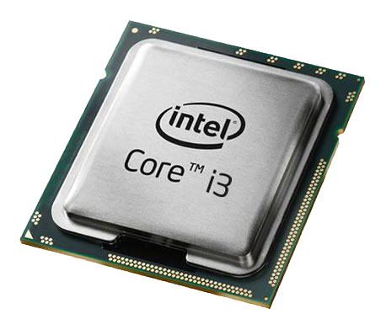
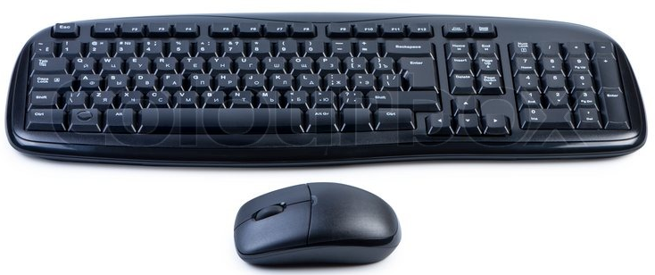
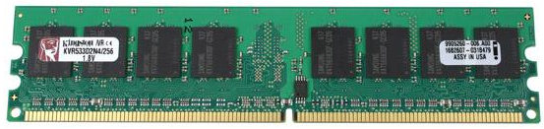
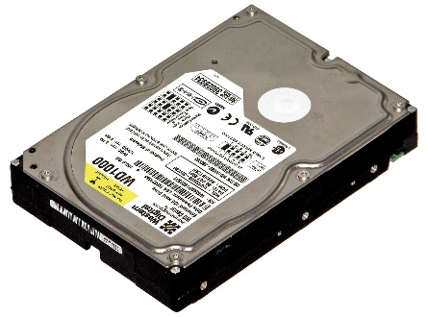

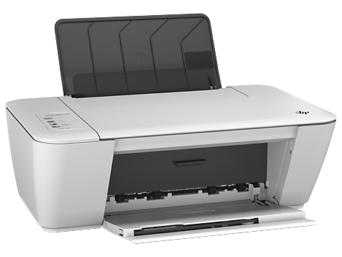
What is Operating System (OS)?
A Computer System consists of various hardwares such as
Processor
RAM
Keyboard & Mouse
Hard Disk
Monitor
Printer
Who manages (controls) these hardwares???
Operating System

Slide 18
Definition of Operating System
An Operating System (OS) is a collection of software that
manages hardware resources
provides various service to the users

Slide 19
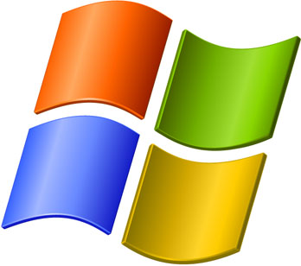
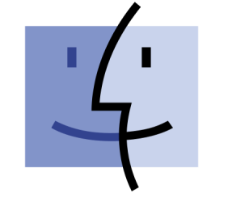


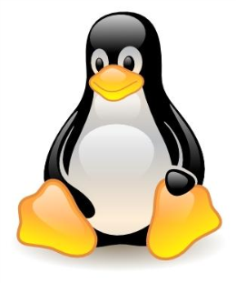
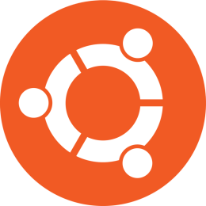
Examples of Operating System
Examples
of Operating System

Slide 20

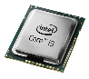
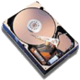

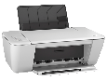
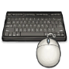
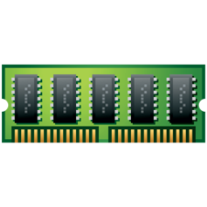
Where OS lies? (Interaction of OS & Hardware)
OS lies between hardware and user program.
It acts as an intermediary between the user and the hardware.
Web
browser
E-mail
reader
Music
player
User Program
Software
Operating System
Hardware

Slide 21
Modes of operation of computer
Kernel Mode
has complete access to all the hardware
can execute any instruction that a machine is capable of executing
has high privileged (rights)
User Mode
can execute only subset (few) of the machine instructions
has less privileged (rights)
Web
browser
E-mail
reader
Music
player
User
Mode
User Program
S/W
Operating System
Kernel
Mode
H/W

Slide 22
Why and How switch occur?
User is writing program in C.
Once finish writing will execute it.
To execute this program
Load program into RAM
Program is executed by processor
Web
browser
Turbo
C
Music
player
User
Mode
user-mode program
performs trap instruction
User Program
S/W
Operating System
Kernel
Mode
H/W

Slide 23
Roles of OS (OS can be viewed as)
The OS as an Extended/Virtual Machine
The OS as a Resource Manager

Slide 24

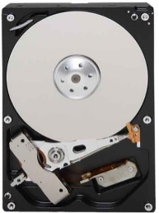
OS as Extended Machine
The architecture of a computer is difficult to program
Architecture (instruction set, memory organization, I/O, bus structure) of most of computer at the machine level language is primitive and awkward to program.
Example: If user want to read from floppy or hard disk:

Slide 25



OS as Extended Machine
Example: If user want to read from floppy or hard disk:
User has to write command and address to the disk controller and then initiate the I/O.
Disk Controller

Slide 26

OS as Extended Machine
Example: If user want to read from floppy or hard disk:
The disk controller will find the requested data in the disk and fetch it from disk to disk controller buffer.
User has to check the status of disk controller operation where it has finished or not.

Slide 27

OS as Extended Machine
Example: If user want to read from floppy or hard disk:
If success, the data from disk controller buffer should be moved to main memory (to the application buffer).

Slide 28
OS as Extended Machine (Cont…)
If all the users will have to do these messy details:
The program will be very difficult to write and quite long.
The program will be hardware dependent.
User don’t want to be involved in programming of storage devices.
Therefore, an OS provides a set of basic commands or instructions to perform various operations such as read, write, modify, save or close.
Dealing with these command is easier than directly dealing with hardware.
Operating system hides the complexity of hardware and present a beautiful interface to the users.

Slide 29

OS as Resource Manager
There are lots of resources in computer system
CPU (Processor)
Memory
I/O devices such as hard disk, mouse, keyboard, printer, scanner etc.
If a computer system is used by multiple applications (or users), then they will compete for these resources.

Slide 30
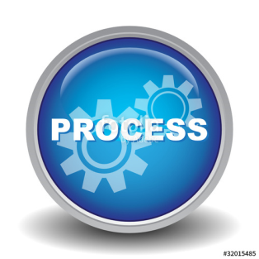
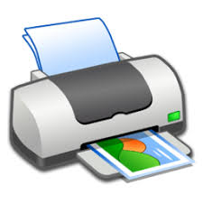

OS as Resource Manager
It is the job of OS to allocate these resources to the various applications so that:
The resources are allocated fairly (equally)
Wants to print 50 lines
P1
After printing 10 lines of P1
Wants to print 20 lines
P2
After printing 20 lines of P1
Wants to print 15 lines
P3
Wants to print 15 lines
P4

Slide 31
OS as Resource Manager
It is the job of OS to allocate these resources to the various applications so that:
The resources are protected from cross-access
Wants to print 50 lines
P1
After printing 10 lines of P1
Wants to print 20 lines
P2
After printing 20 lines of P1
Wants to print 15 lines
P3
Wants to print 15 lines
P4

Slide 32
OS as Resource Manager
It is the job of OS to allocate these resources to the various applications so that:
Access to the resources is synchronized so that operations are correct and consistent
Example: If we write a program to calculate below in C language
7 + 9 – 6 * 4 / 2 = 4
20
P1
P2
P3
P4
3
4
1
2

Slide 33
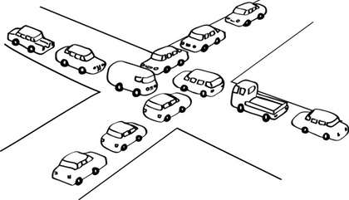
OS as Resource Manager
It is the job of OS to allocate these resources to the various applications so that:
Deadlock are detected, resolved and avoided.

Slide 34
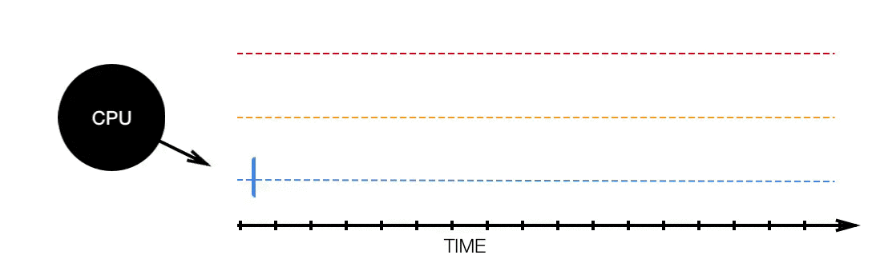
OS as Resource Manager (Cont…)
Resource manager – sharing resources in two different ways:
In time sharing/multiplexing (i.e CPU)

Slide 35
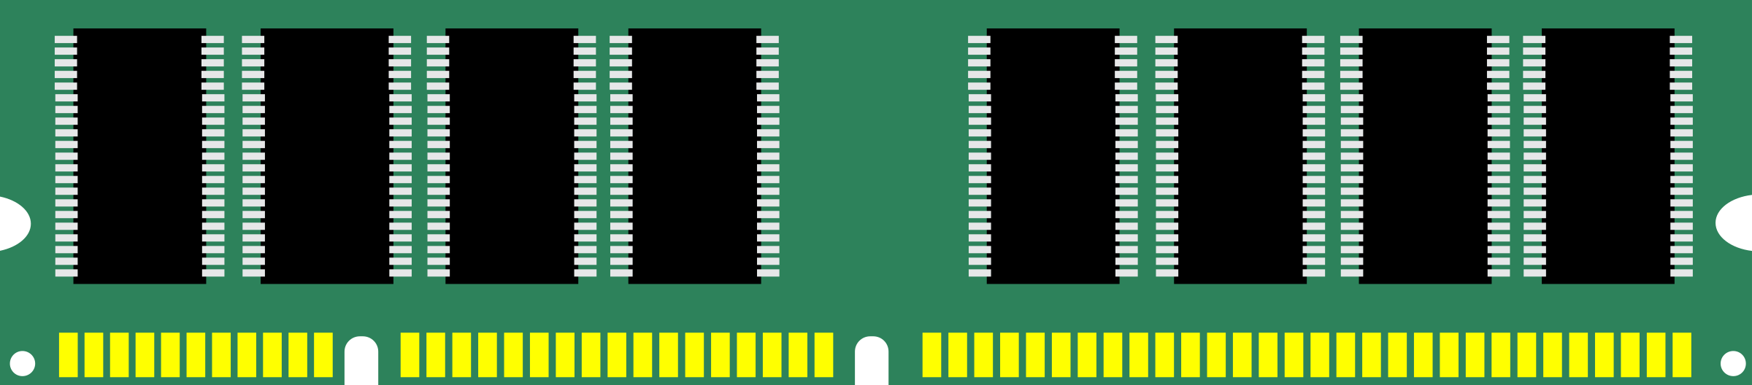
OS as Resource Manager (Cont…)
Resource manager – sharing resources in two different ways
In space sharing/multiplexing. (i.e Memory)
Process 1
Process
2
Process
3
Empty Space
Main Memory

Slide 36
Objectives / Goals of Operating System
Make the computer system convenient to use in an efficient manner.
Hide the details of the hardware resources from the users.
Provide users a convenient interface to use the computer system.
Act as an intermediary between the hardware and its users, making it easier for the users to access and use other resources.
Manage the resources of a computer system.
Keep track of who is using which resource, granting resource requests, and mediating conflicting requests from different programs and users.
Provide efficient and fair sharing of resources among users and programs.

Slide 37
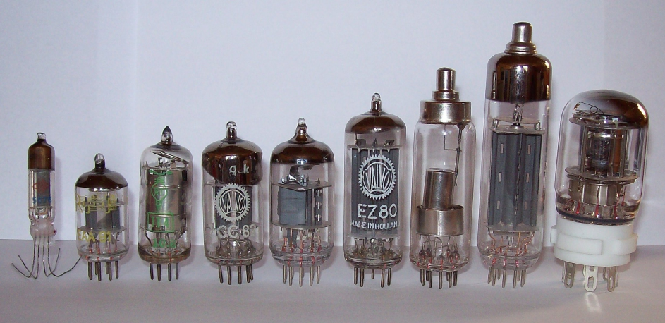
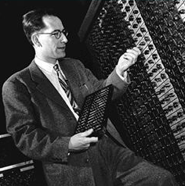
History of OS (First generation)
First generation (1945-1955)
Vacuum tubes and plug-boards are used in these systems.
Vacuum tubes
Plug board

Slide 38
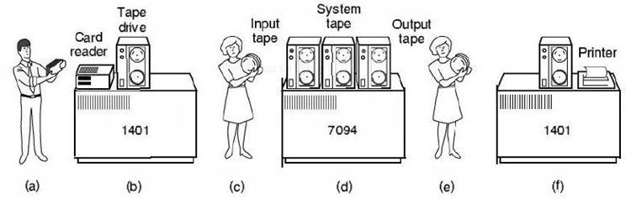
History of OS (Second generation)
Second generation (1955-1965)
Transistors are used in these systems
The machine that are produced are called mainframes.
Batch systems was used for processing.
Programmers bring cards to 1401
1401 prints output
1401 reads batch of jobs onto tape
Operator carries input tape to 7094
7094 does computing
Operator carries output tape to 1401

Slide 39
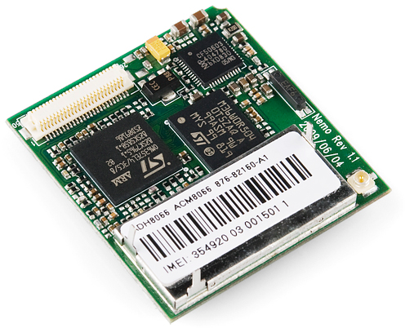
History of OS (Third generation)
Third generation (1965-1980)
Integrated circuits (IC's) are used in place of transistors in these computers.
It provides multiprogramming (the ability to have several programs in memory at once, each in its own memory partition).

Slide 40
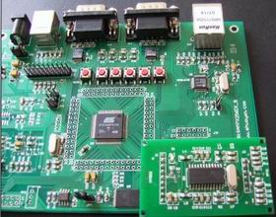
History of OS (Fourth generation)
Fourth generation (1980-present)
Personal Computers
LSI (Large Scale Integration) circuits, chips containing thousands of transistors are used in these systems.

Slide 41
Services / Functions / Tasks of OS
Definition of Operating System
An Operating System (OS) is a collection of software that
manages hardware resources
provides various service to the users

Slide 42

Services / Functions / Tasks of OS
Program development
It provides editors and debuggers to assist (help) the programmer in creating programs.

Slide 43
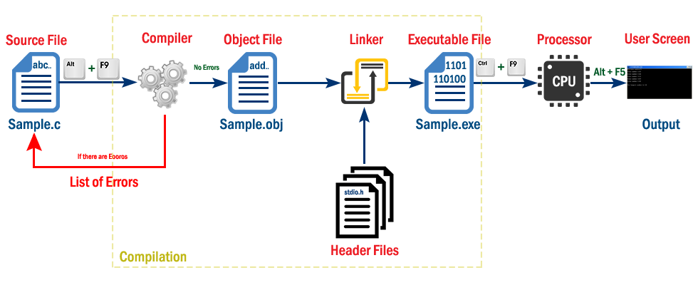
Services / Functions / Tasks of OS
Program execution
Following tasks need to be perform to execute a program:
Instructions and data must be loaded into main memory.
I/O devices and files must be initialized.
The OS handles all these duties for the user.

Slide 44

Services / Functions / Tasks of OS
Access to I/O devices (Resource allocation)
A running program may require I/O, which may involve file or an I/O device.
For efficiency and protection, users cannot control I/O devices directly.
Therefore, the OS controls these I/O devices and provides to program as per requirement.

Slide 45
Services / Functions / Tasks of OS
Memory management
OS manages memory hierarchy.
OS keeps the track of which part of memory area in use in use and free memory.
It allocates memory to program when they need it.
It de-allocate the memory when the program finish execution.
P1
P2

Slide 46
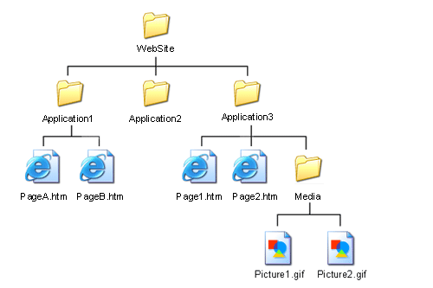
Services / Functions / Tasks of OS
Controlled access to file
In case of file access, OS provides a directory hierarchy for easy access and management of file.
OS provides various file handling commands using which user can easily read, write and modify file.

Slide 47
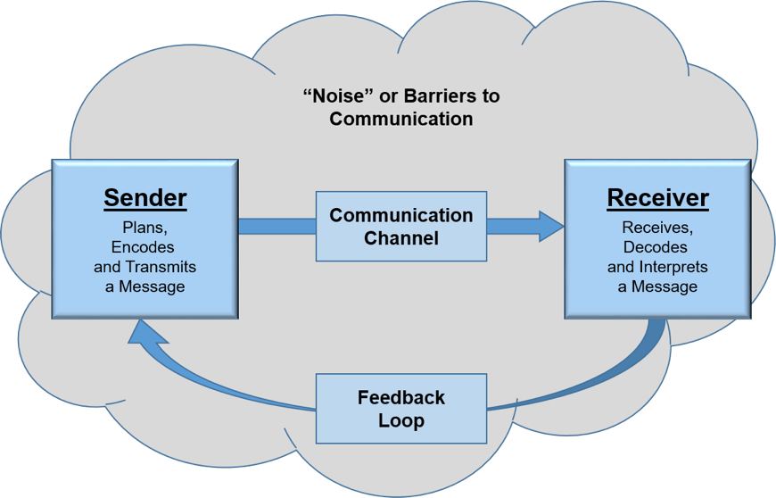
Services / Functions / Tasks of OS
Communication
In multitasking environment, the processes need to communicate with each other and to exchange their information.
Operating system performs the communication among various types of processes in the form of shared memory.

Slide 48
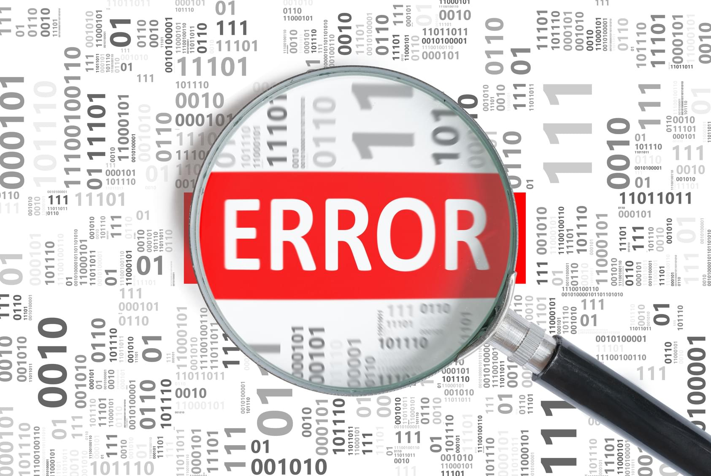
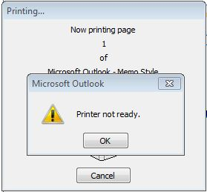
Services / Functions / Tasks of OS
Error detection and response
An error may occur in CPU, in I/O devices or in the memory hardware.
Following are the major activities of an operating system with respect to error handling −
The OS constantly checks for possible errors.
The OS takes an appropriate action to ensure correct and consistent computing.

Slide 49
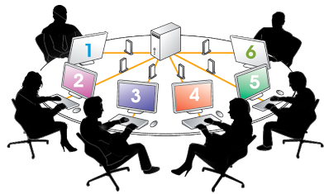
Services / Functions / Tasks of OS
Accounting
Keeping a track of which users are using how much and what kinds of computer resources can be used for accounting or simply for accumulating usage statistics.
Usage statistics is used to reconfigure the system to improve computing services.

Slide 50
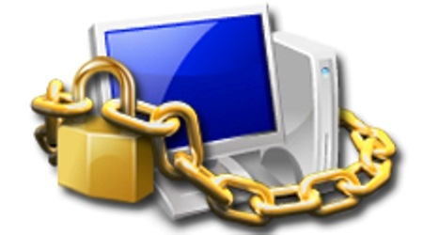
Services / Functions / Tasks of OS
Protection & Security
Protection involves ensuring that all accesses to system resources is controlled.
To make a system secure, the user needs to authenticate himself or herself to the system.

Slide 51
Services / Functions / Tasks of OS (Revision)
Program development
Program execution
Access to I/O devices
Memory management
Controlled access to file
Communication
Error detection and response
Accounting
Protection & Security

Slide 52
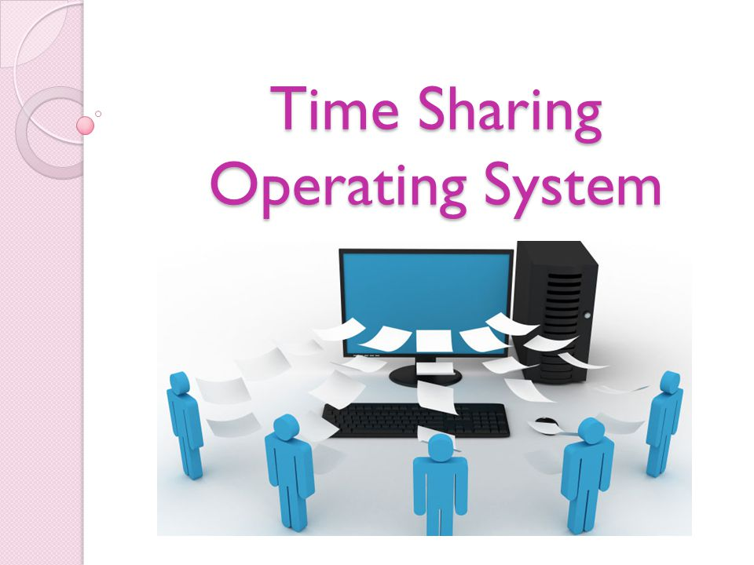
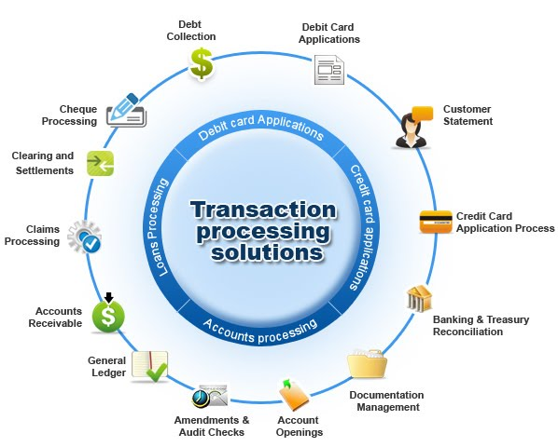
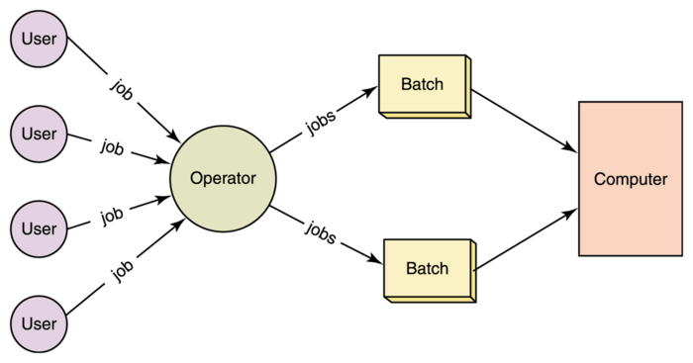
Types of OS
Mainframe operating systems
OS found in room sized computers which are still found in major corporate data centres.
They offer three kinds of services:
Batch OS – processes routine jobs without any interactive user presents i.e. claim processing in insurance
Transaction processing – handles large numbers of small processes i.e. cheque processing at banks
Timesharing – allows multiple remote users to run their jobs at once i.e. querying a database, airline booking system
Examples: OS/390, OS/360.

Slide 53
Types of OS
Mainframe operating systems
OS found in room sized computers which are still found in major corporate data centres.
They offer three kinds of services:
Batch OS – processes routine jobs without any interactive user presents i.e. claim processing in insurance
Transaction processing – handles large numbers of small processes i.e. cheque processing at banks
Timesharing – allows multiple remote users to run their jobs at once i.e. querying a database, airline booking system
Examples: OS/390, OS/360.

Slide 54
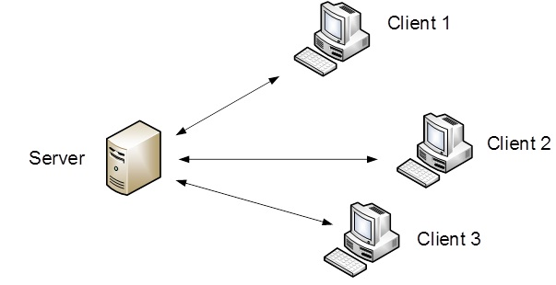
Types of OS (Cont…)
Server operating systems
This OS runs on servers which are very large PC, workstations or even mainframes.
They serve multiple users at once over a network and allow the users to share hardware & software resources.
It provides print services, file service or web service.
It handles the incoming requests from clients.
Examples: Solaris, FreeBSD, and Linux and Windows Server 200x.

Slide 55
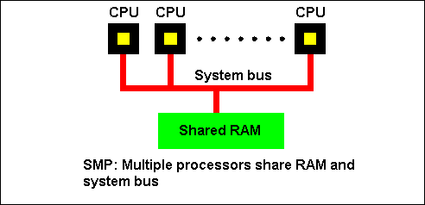
Types of OS (Cont…)
Multiprocessor operating systems
A computer system consist two or more CPUs is called multiprocessor.
It is also called parallel computers, multicomputer or multiprocessor.
They need special OS or some variations on server OS with special features for communication, connectivity and consistency.
Examples: Windows and Linux.

Slide 56
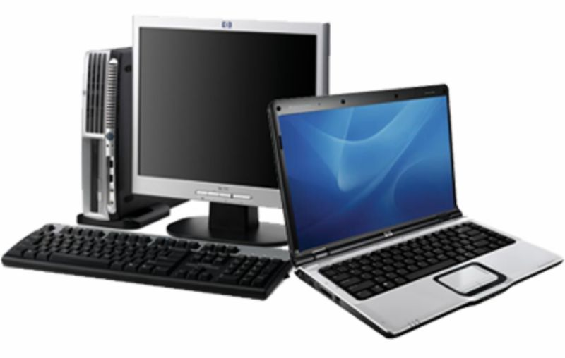
Types of OS (Cont…)
Personal computer operating systems
The operating systems installed on our personal computer and laptops are personal OS.
Job of this OS is to provide good support to single user.
This OS is widely used for word processing, spreadsheet and internet access.
Examples: Linux, Windows vista and Macintosh.

Slide 57
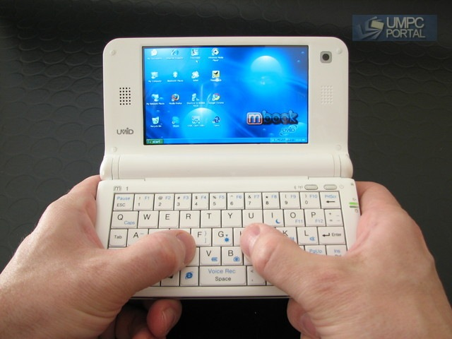
Types of OS (Cont…)
Handhelds computer operating systems
A handheld computer or PDA (Personal Digital Assistant) is small computer that fit in a Pocket and perform small number of functions such as electronic address book, memo pad.
The OS runs on these devices are handheld OS.
These OS also provides ability to handle telephony, digital photography and other functions.
Examples: Symbian OS, Palm OS.

Slide 58
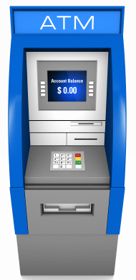
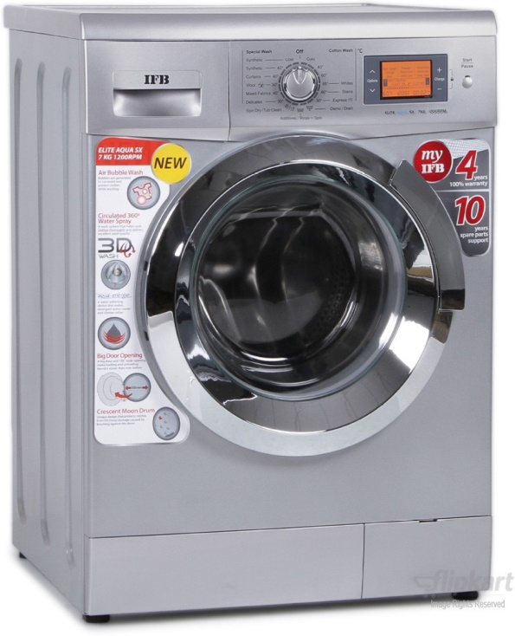
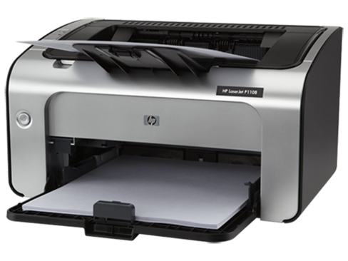
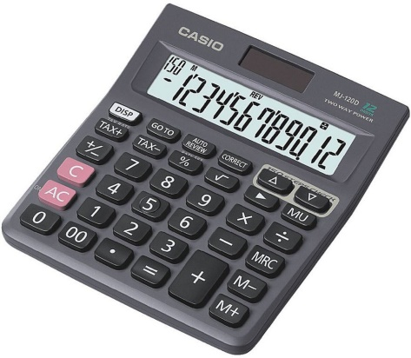
Types of OS (Cont…)
Embedded operating systems
This OS is installed in ATMs, printers, calculators and washing machine.
It runs on the computer that control devices.
It neither allow to download new software nor accept user installed software. So there is no need for protection.
Examples: QNX, VxWorks.

Slide 59
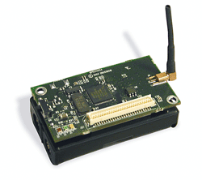
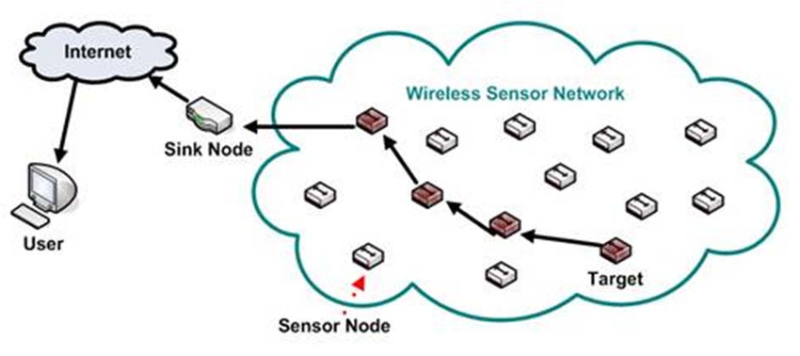
Types of OS (Cont…)
Sensor node operating systems
Network of tiny sensor nodes are being developed for numerous purpose.
Each nodes are tiny computers with a CPU, RAM, ROM and one or more environmental sensors.
The OS installed in these nodes are sensor node OS.
They communicate with each other and with base station using wireless communication.
These sensor network are used to protect area of building, detect fires in forest, measure temperature.
Examples: TinyOS.

Slide 60
Types of OS (Cont…)
Real time operating systems
These systems having time as a key parameter.
Real time OS has well defined fixed time constraints.
Processing must be done within defined time constraints otherwise system fails.
Two types of real time OS:
Hard real time – missing an occasional deadline can cause any permanent damage. Many of these are found in industrial process control, car engine control system.
Soft real time – missing an occasional deadline does not cause any permanent damage. Used in digital audio, multimedia system.
Examples: e-Cos.

Slide 61
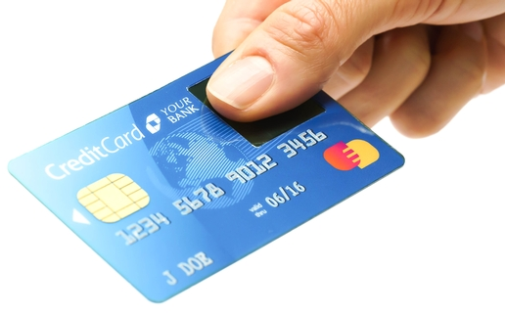
Types of OS (Cont…)
Smart card operating systems
Smallest OS run on smart cards which are credit card sized devices containing CPU chip.
These OS are installed on electronic payments cards such as debit card, credit card etc.
They have limited processing power.
Some smart cards are Java oriented. ROM on smart card holds an interpreter for the JVM – small program.

Slide 62
Types of OS (Revision)
Mainframe operating systems
Server operating systems
Multiprocessor operating systems
Personal computer operating systems
Handhelds computer operating systems
Embedded operating systems
Sensor node operating systems
Real time operating systems
Smart card operating systems

Slide 63
System calls
The interface between OS and user program is defined by the set of system calls that OS provides.
System calls vary from OS to OS.
Example: In Unix Read system call is
count=read(fd, buffer, nbytes)
fd is a file descriptor.
When a file is opened, permissions are checked.
If access is allowed, a number (fd) is returned.
Then file can be read/written.
nbytes is number of bytes to read
buffer is where read deposits (stores) the data

Slide 64
System calls (Cont…)
Return to caller
Library
procedure
read
Trap to the kernel
5
Put code for read in register
6
10
User
space
Call to library proc
4
11
Increment SP
Call read
User
program
calling read
Push parameter onto stack
3
Push fd
2
Push &buffer
9
1
Push nbytes
Kernel
space
7
8
Dispatch
Sys call
handler

Slide 65
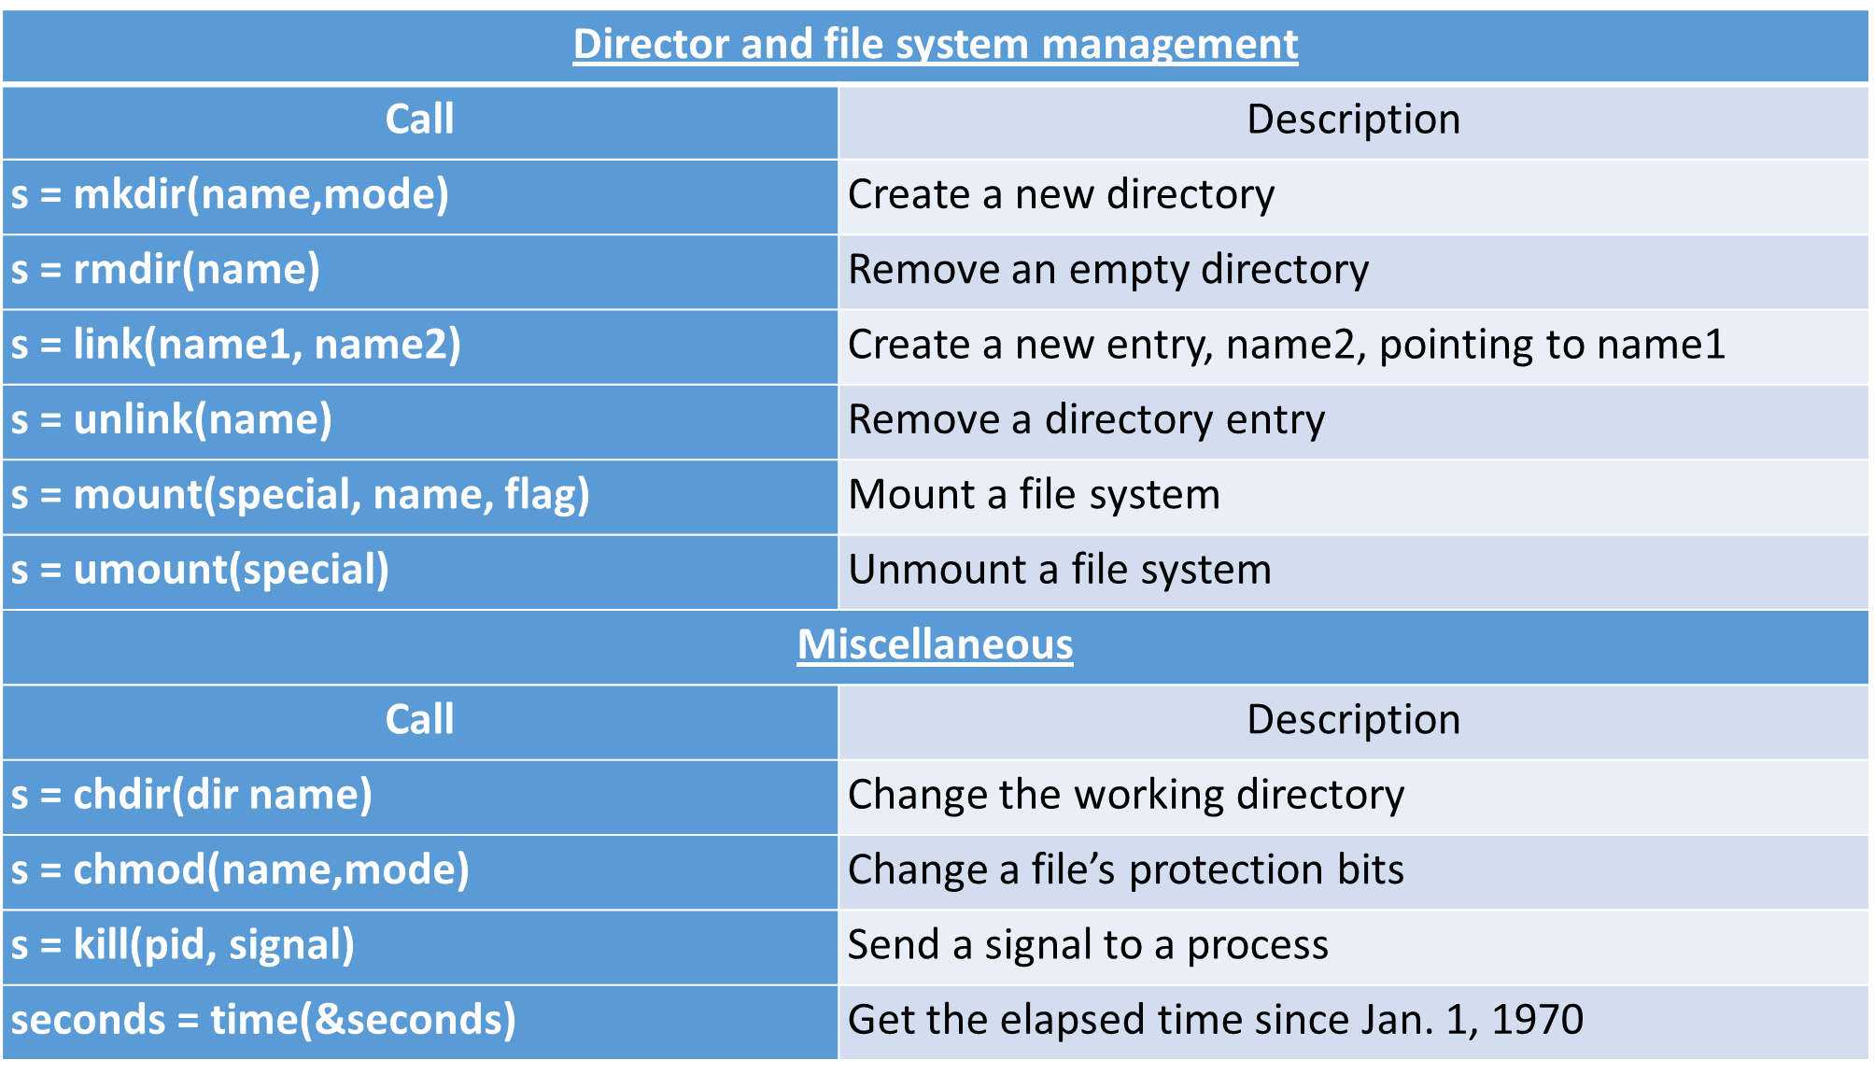
System Calls (Cont…)

Slide 66
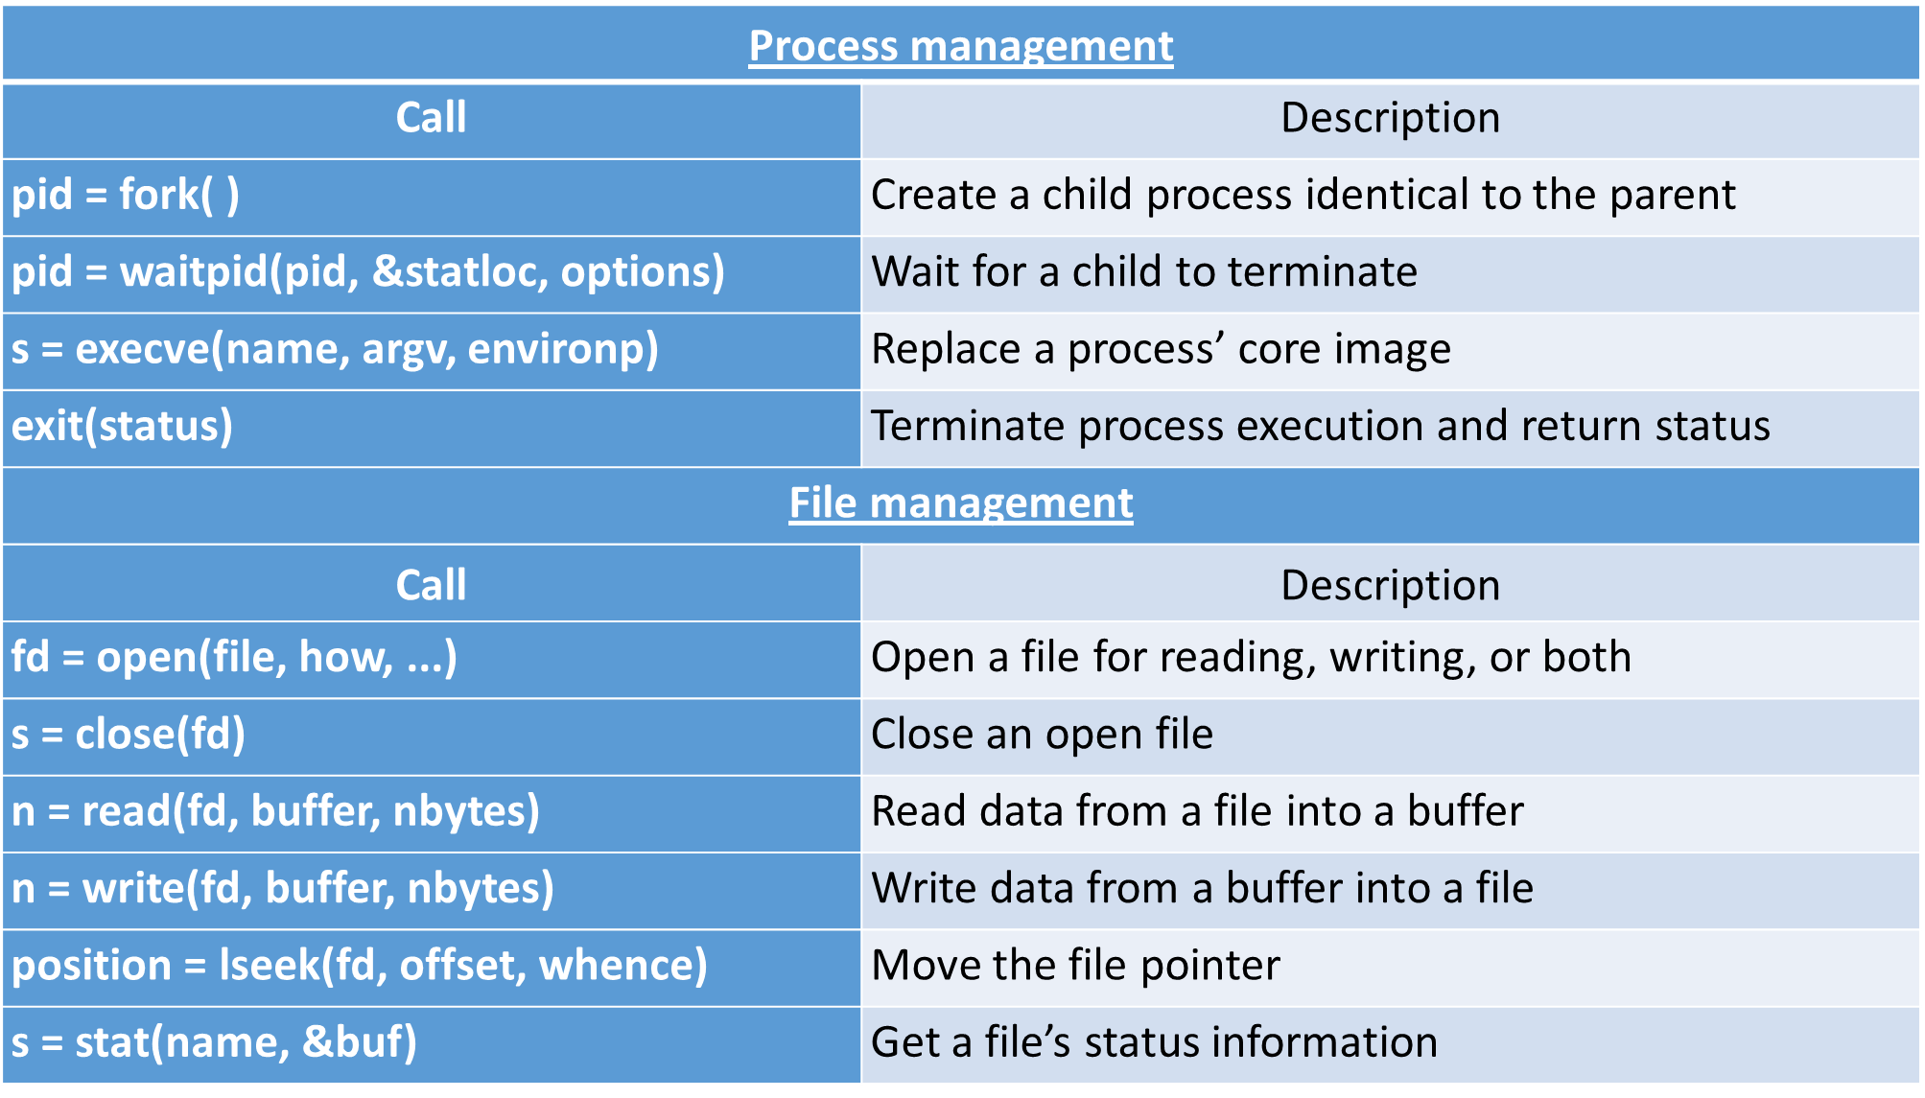
System Calls (Cont…)

Slide 67
Operating system structures
Monolithic systems
Layered systems
Microkernel
Client-server model
Virtual machines
VM/370
Virtual machines rediscovered
The java virtual machine
Exokernels

Slide 68
Monolithic systems
The entire OS runs as a single program in kernel mode.
OS is written as a collection of procedures, linked together into a single large executable binary program.
Each procedure has well defined interface in terms of parameter and results, and each one is free to call any other one.
A main program that invoke the requested service procedure.
A set of service procedures that carry out the system calls.
A set of utility procedures that help the service procedure.
Main
Procedure
Service
Procedures
Utility
Procedure

Slide 69
Layered systems
In this system, the OS is organized as a hierarchy of layers.
The first system constructed in this way was THE system.

Slide 70
Architecture of THE system
Layer | Function | Description
5 | The operator | Operator was located.
4 | User Programs | User programs were found.
3 | Input / Output Management | Takes care of managing the I/O devices. Buffering the information.
2 | Operator-process communication | Handles communication between each process and the operator console (i.e. user).
1 | Memory and drum management | Did the memory management. Allocated space for process in main memory and on a 512K word drum used for holding parts of processes for which there was no room in memory.
0 | Processor allocation and multi-programming | Provided the basic multiprogramming of the CPU. Dealt with allocation of the processor, switching between processes when interrupts occurred or timers expired.

Slide 71
Microkernel
In layered approach, the designer have choice where to draw the kernel and user mode boundary.
It is better to put as little as possible in kernel mode because bugs in the kernel can bring down the system instantly.
The microkernel design provides high reliability by splitting OS up into small well defined modules, only one module run in kernel and rest of all run in user mode.
As each device driver runs as a user process, a bug in audio driver will cause the sound to be stop, but not crash the computer.
Examples: Integrity, K42, QNX, Symbian and MINIX 3.

Slide 72

Microkernel (Cont…)
Kernel contains only
Sys (Kernel call handler)
Clock (because scheduler interact with it)

Slide 73

Client-Server model
Processes are divided into two categories
Servers: provide services
Clients: uses services
Client and server run on different computers, connected by LAN or WAN and communicate via message passing.
To obtain a service, a client construct a message saying what it wants and send it to server.
The server then does the work and send back the answer.

Slide 74
Virtual machines
The initial releases of OS/360 were strictly batch systems.
But many users wanted to be able to work interactively at a terminal, so OS designers decided to write timesharing systems for it.
Types of Virtual machines are:
VM/370
Virtual Machines Rediscovered
The Java Virtual Machine

Slide 75

VM/370
Virtual machine monitor run on the bare hardware and does the multiprogramming.
Each virtual machine is identical to the true hardware; each one can run any OS (may be different) that will run directly on the bare hardware.
On VM/370, some run OS/360 while the others run single user interactive system called CMS (Conversational Monitor System) for interactive time sharing users.

Slide 76
VM/370 (Cont…)
When CMS program executed a system call, a call was trapped to the operating system in its own virtual machine, not on VM/370.
CMS then issued the normal hardware I/O instruction for reading its virtual disk or whatever was needed to carry out the call.
These I/O instructions were trapped by VM/370 which then performs them.

Slide 77

Virtual Machines Rediscovered
Companies can run their mail servers, web servers, FTP servers and other servers on the same machine without having a crash of one server bring down the rest.
Web hosting company offers virtual machines for rent, where a single physical machine can run many virtual machines; each one appears to be a complete machine.
Customers who rent a virtual machine can run any OS or software.

Slide 78
Virtual Machines Rediscovered (Cont…)
Another use of virtualization is for end users who want to be able to run two or more operating systems at the same time, say Windows and Linux.
Type 1 hypervisors runs on the bare hardware.
Type 2 hypervisors run as application programs on top of Windows, Linux, or some other operating system, known as the host operating system.

Slide 79

Java Virtual Machine
When Sun Microsystems invented the Java programming language, it also invented a virtual machine called the JVM (Java Virtual Machine).
The Java compiler produces code for JVM, which then typically is executed by a software JVM interpreter.
The advantage is that the JVM code can be shipped over the internet to any computer that has a JVM interpreter and run there.

Slide 80
Exokernels
Rather than cloning (copying) the actual machine, another strategy is partitioning it (giving each user a subset of the resource).
For example one virtual machine might get disk blocks 0 to 1023, the next one might get block 1024 to 2047, and so on.
Program running at the bottom layer (kernel mode) is called the exokernel.
Its job is to allocate resources to virtual machines and then continuously check to make sure no machine is trying to use somebody else’s resources.
The advantage of the exokernel scheme is that it saves a layer of mapping.

Slide 81





Multiprogramming v/s Multiprocessing v/s Multitasking
Multiprocessing
Multitasking
Multiprogramming

Slide 82
Multiprogramming v/s Multiprocessing v/s Multitasking
Multiprogramming | Multiprocessing | Multitasking
The concurrent residency of more than one program in the main memory is called as multiprogramming. | The availability of more than one processor per system, which can execute several set of instructions in parallel is called as multiprocessing. | The execution of more than one task simultaneously is called as multitasking.
Number of processor: one | Number of processor: more than one | Number of processor: one
One process is executed at a time. | More than one process can be executed at a time. | One by one job is being executed at a time.

Slide 83


Time Sharing Operating System
A time sharing operating system allows many users to share the computer resources simultaneously.
In other words, time sharing refers to the allocation of computer resources in time slots to several programs simultaneously.
For example a mainframe computer that has many users logged on to it.
Each user uses the resources of the mainframe i.e. memory, CPU etc.

Slide 84
Parallel Processing Operating System
Parallel Processing Operating Systems are designed to speed up the execution of programs by dividing the program into multiple fragments and processing these fragments simultaneously.
Such systems are multiprocessor systems.
Parallel systems deal with the simultaneous use of multiple computer resources that can include a single computer with multiple processors.
Multiprocessing

Slide 85

Distributed Operating System
Distributed Operating System is a model where distributed applications are running on multiple computers linked by communications.
A distributed operating system is an extension of the network operating system that supports higher levels of communication and integration of the machines on the network.

Slide 86
Questions asked in GTU
What is Kernel? Differentiate between Monolithic Kernel and Micro Kernel.
Explain different service/functions provided by operating system.
Discuss role of OS as a resource manager.
Explain the features of Time sharing system.
What is operating system? Give the view of OS as a resource manager.
What is system call? Explain steps for system call execution.
Write different types of system call.
List out types of operating system and explain batch OS and time sharing OS in brief.

Slide 87


